Slide 1
Topic 03 Data Warehousing
ICT394 BI Application
Development

Slide 2
Resources
As this topic is essentially revision, there is no set reading, however, you should read over your notes or textbook from your previous databases study to refresh your memory about data warehousing. If you do not have access to those resources, just about any databases text will have a section on data warehousing that you will be able to read
Case Study:
2011, Chrysler’s Data Quality Management Case Study, https://www.youtube.com/watch?v=N78lHpiCD0k

Slide 3
Learning Outcomes
At the completion of this topic, you should be able to:
Provide a definition of a data warehouse, including examples as to how and in what circumstances it would be used
Describe and provide examples as to the difference between operational and analytical databases
Discuss the components of a data warehouse system
Discuss the basic steps in the development of a data warehouse
This topic contributes to the following unit learning outcomes:
Describe the common data sources that exist in organisations and their use in BI
Demonstrate practical skills in the processes associated with extraction, transformation and loading (ETL) of organisational data
Design and implement a simple data warehouse environment

Slide 4
Lecture Outline
Introduction
Operational Vs Analytical Databases
Data Warehouse Definition
Data Warehouse Components
Data Warehouse Development
Conclusion

Slide 5
ICT394 Business Intelligence Application Development
Topic 03: Part 02
Operational Vs Analytics Databases

Slide 6
Types of information in organisations
Two primary types of information
Operational information (transactional information)
the information collected and used in support of day-to-day operational needs in businesses and other organisations
Analytical information
the information collected and used in support of analytical tasks
Analytical information is based on operational (transactional) information

Slide 7
DW as a separate structure
The data warehouse is created as a separate database because:
The analytical tasks the data warehouse will have to complete will detract from the performance of the operational databases
The analytical tasks will often require data from multiple operational data sources; it may be impossible to design an operational database that will be able to fulfil these requirements

Slide 8
Operational Vs. Analytical Information
Operational Data Analytical Data
Data Makeup Differences
Typical Time-Horizon: Days/Months Typical Time-Horizon: Years
Detailed Summarized (and/or Detailed)
Current Values over time (Snapshots)
Technical Differences
Small Amounts used in a Process Large Amounts used in a Process
High frequency of Access Low/Modest frequency of Access
Can be Updated Read (and Append) Only
Non-Redundant Redundancy not an Issue Functional Differences
Used by all types of employees for Used by a narrower set of
tactical purposes users for decision making
Application Oriented Subject Oriented

Slide 9
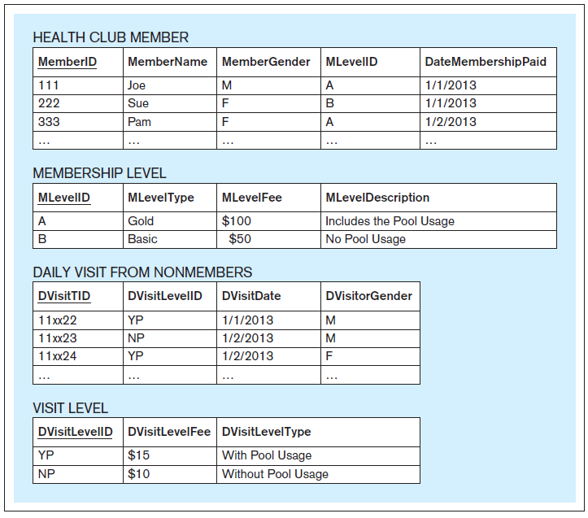
Application Oriented vs. Subject Oriented– Example
An application-oriented database serving the Vitality Health Club Visits and Payments Application
(from: Jukic, et. al., 2014, p.211).

Slide 10
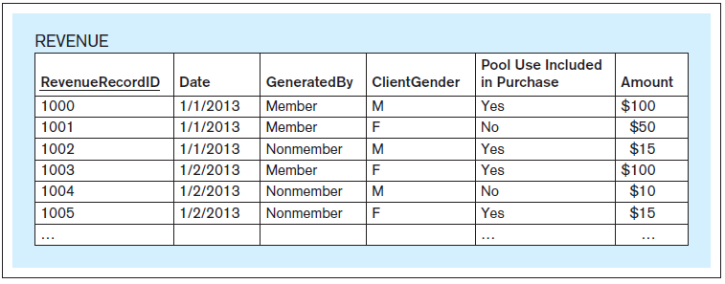
Application Oriented vs. Subject Oriented– Example
A subject-oriented database for the analysis of the subject revenue in the Vitality Health Club (from: Jukic, et. al., 2014, p.211).

Slide 11
ICT394 Business Intelligence Application Development
Topic 03: Part 03
Data Warehouse Definition

Slide 12
The Data Warehouse Definition
The data warehouse is a structured repository of integrated, subject-oriented, enterprise-wide, historical, and time-variant data.
The purpose of the data warehouse is the retrieval of analytical information.
A data warehouse can store detailed and/or summarized data.

Slide 13
Structured repository
The data warehouse is a database containing analytically useful information
Any database is a structured repository with its structure represented in its metadata

Slide 14
Integrated
The data warehouse integrates the analytically useful data from the various operational databases (and possibly other sources)
Integration refers to this process of bringing the data from multiple data sources into a singular data warehouse.

Slide 15
Subject-Oriented
The term subject-oriented refers to the fundamental difference in the purpose of an operational database system and a data warehouse.
An operational database system is developed in order to support a specific business operation
A data warehouse is developed to analyze specific business subject areas

Slide 16
Enterprise-wide
The term enterprise-wide refers to the fact that the data warehouse provides an organization-wide view of the analytically useful information it contains

Slide 17
Historical
The term historical refers to the larger time horizon in the data warehouse than in the operational databases

Slide 18
Time-variant
The term time variant refers to the fact that a data warehouse contains slices or snapshots of data from different periods of time across its time horizon
With the data slices, the user can create reports for various periods of time within the time horizon

Slide 19
Retrieval of analytical information
A data warehouse is developed for the retrieval of analytical information, and it is not meant for direct data entry by the users.
The only functionality available to the users of the data warehouse is retrieval
The data in the data warehouse is not subject to changes.
The data in the data warehouse is referred to as non-volatile, static, or read-only

Slide 20
Detailed and/or summarized data
A data warehouse, depending on its purpose, may include the detailed data or summary data or both
A data warehouse that contains the data at the finest level of detail is the most powerful

Slide 21
The Data Warehouse Definition
The data warehouse is a structured repository of integrated, subject-oriented, enterprise-wide, historical, and time-variant data.
The purpose of the data warehouse is the retrieval of analytical information.
A data warehouse can store detailed and/or summarized data.

Slide 22
ICT394 Business Intelligence Application Development
Topic 03: Part 04
Data Warehouse Components

Slide 23
Data Warehouse Components
Source systems
Extraction-transformation-load (ETL) infrastructure
Data warehouse
Front-end applications

Slide 24
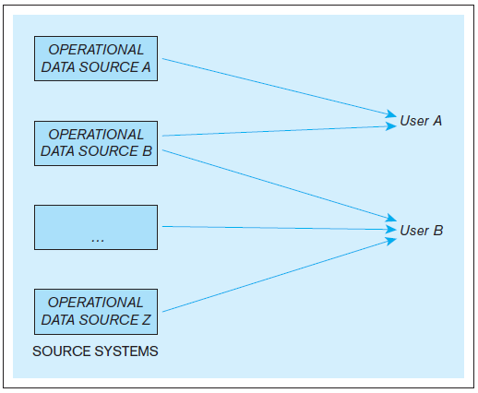
Example - The use of operational data sources for operational purposes in an organization
(from: Jukic, et. al., 2014, p.214).

Slide 25
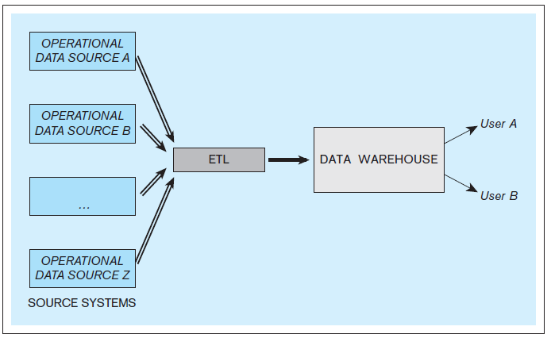
Example - The core components of a data warehousing system
(from: Jukic, et. al., 2014, p.215).

Slide 26
Source systems
In the context of data warehousing, source systems are operational databases and other operational data repositories (in other words, any sets of data used for operational purposes) that provide analytically useful information for the data warehouse's subjects of analysis
Every operational data store that is used as a source system for the data warehouse has two purposes:
The original operational purpose
As a source system for the data warehouse (re-purposing)
Source systems can include external data sources

Slide 27
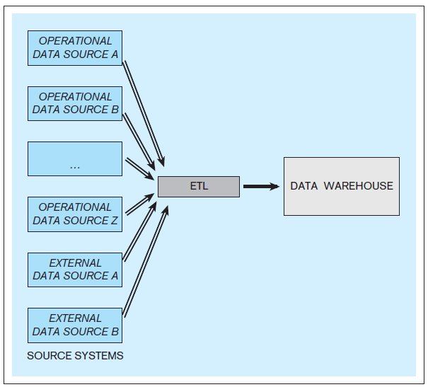
Example - A data warehouse with internal and external source systems
(from: Jukic, et. al., 2014, p.216).

Slide 28
Data Warehouse
The data warehouse is sometimes referred to as the target system, to indicate the fact that it is a destination for the data from the source systems
A typical data warehouse periodically retrieves selected analytically useful data from the operational data sources

Slide 29
ETL infrastructure
The infrastructure that facilitates the retrieval of data from operational databases into the data warehouses
ETL includes the following tasks:
Extracting analytically useful data from the operational data sources
Transforming such data so that it conforms to the structure of the subject-oriented target data warehouse model (while ensuring the quality of the transformed data)
Loading the transformed and quality assured data into the target data warehouse

Slide 30
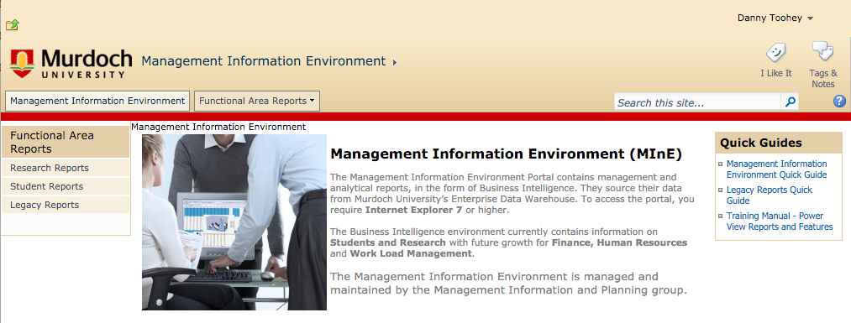
Data warehouse front-end (BI) applications
Used to provide access to the data warehouse for users who are engaging in indirect use
Recall the case study from Topic 2 where end users were given access to reports from the university system

Slide 31
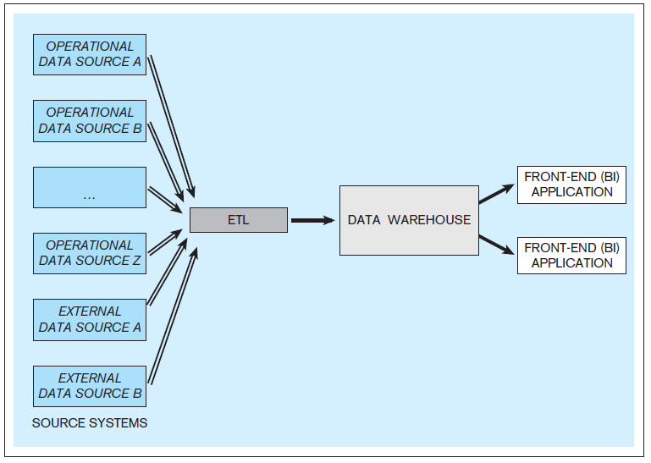
Example - A data warehouse with front-end applications
(from: Jukic, et. al., 2014, p.217).

Slide 32
Data Warehouse Components
Source systems
Extraction-transformation-load (ETL) infrastructure
Data warehouse
Front-end applications

Slide 33
ICT394 Business Intelligence Application Development
Topic 03: Part 05
Data Warehouse Development

Slide 34
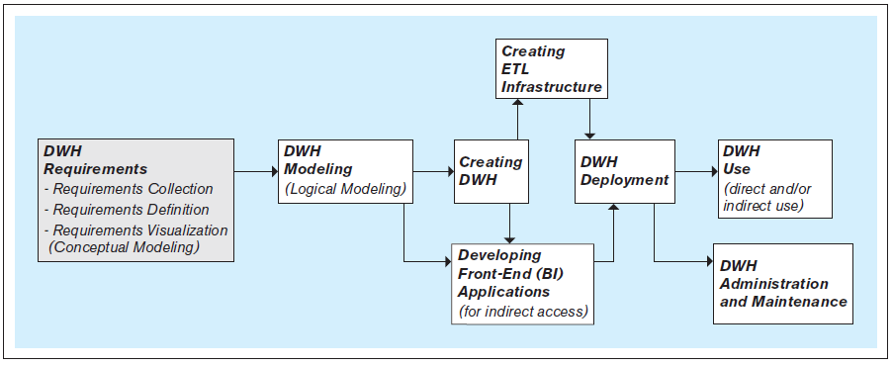
Steps In The Development Of Data Warehouses
(from: Jukic, et. al., 2014, p.218).

Slide 35
Requirements collection, definition and visualization
This step results in the requirements specifying the desired capabilities and functionalities of the future data warehouse
The requirements are based on the analytical needs that can be met by the data in the internal data source systems and available external data sources
The requirements are collected through interviewing various stakeholders of the data warehouse
In addition to interviews, additional methods for eliciting requirements from the stakeholders can be used

Slide 36
Requirements collection, definition, and visualization
The collected requirements should be clearly defined and stated in a written document, and then visualized as a conceptual data model

Slide 37
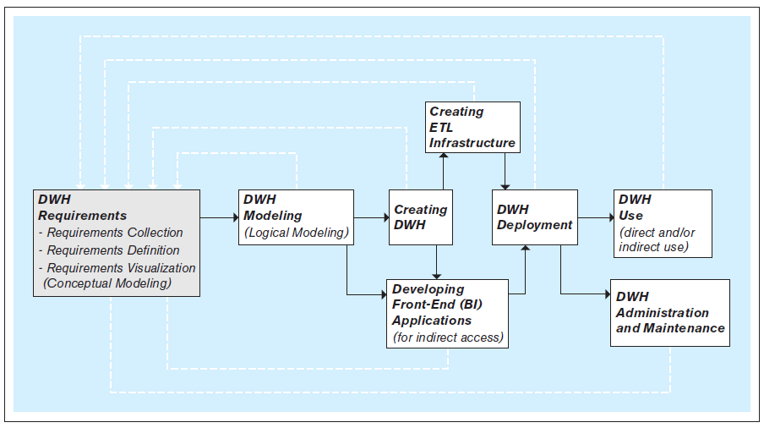
Iterative nature of the data warehouse requirements collection, definition, and visualization process
(from: Jukic, et. al., 2014, p.219).

Slide 38
Data warehouse modeling
AKA: logical data warehouse modeling
creation of the data warehouse data model that is implementable by the DBMS
This is the focus of the next topic

Slide 39
Creating The Data Warehouse
Using a DBMS to implement the data warehouse data model as an actual data warehouse
Typically, data warehouses are implemented using a relational DBMS (RDBMS) software

Slide 40
Creating ETL infrastructure
Creating necessary procedures and code for:
Automatic extraction of relevant data from the operational data sources
Transformation of the extracted data, so that its quality is assured and its structure conforms to the structure of the modeled and implemented data warehouse
The seamless load of the transformed data into the data warehouse
Due to the amount of details that have to be considered, creating ETL infrastructure is often the most time- and resource-consuming part of the data warehouse development process

Slide 41
Developing front-end (BI) applications
Designing and creating applications for indirect use by the end-users
Front-end applications are included in most data warehousing systems and are often referred to as business intelligence (BI) applications
Front-end applications contain interfaces (such as forms and reports) accessible via a navigation mechanism (such as a menu)

Slide 42
Data warehouse deployment
Releasing the data warehouse and its front-end (BI) applications for use by the end users

Slide 43
Data warehouse use
The retrieval of the data in the data warehouse
Indirect use
Via the front-end (BI) applications
Direct use
Via the DBMS
Via the OLAP (BI) tools

Slide 44
Data warehouse administration and maintenance
Performing activities that support the data warehouse end user, including dealing with technical issues, such as:
Providing security for the information contained in the data warehouse
Ensuring sufficient hard-drive space for the data warehouse content
Implementing the backup and recovery procedures

Slide 45
Steps In The Development Of Data Warehouses
(from: Jukic, et. al., 2014, p.218).

Slide 46
ICT394 Business Intelligence Application Development
Topic 03: Part 06
Topic Summary

Slide 47
Conclusion
At the completion of this topic, you should be able to:
Provide a definition of a data warehouse, including examples as to how and in what circumstances it would be used
Describe and provide examples as to the difference between operational and analytical databases
Discuss the components of a data warehouse system
Discuss the basic steps in the development of a data warehouse

Slide 48
References
Jukic, N., Vrksky, S., and Nestorov, S., 2014, Database Systems: Introduction to Databases and Data Warehouses, Pearson Education Inc., Boston.

